Slide 1

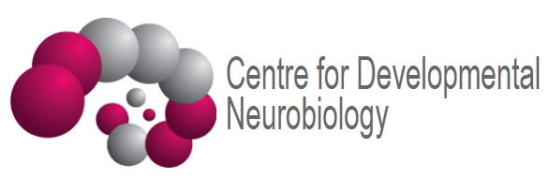
Sensory Receptors
Vincenzo Mastrolia
Research Associate
Centre for Developmental Neurobiology (CDN)
King’s College London

Slide 2
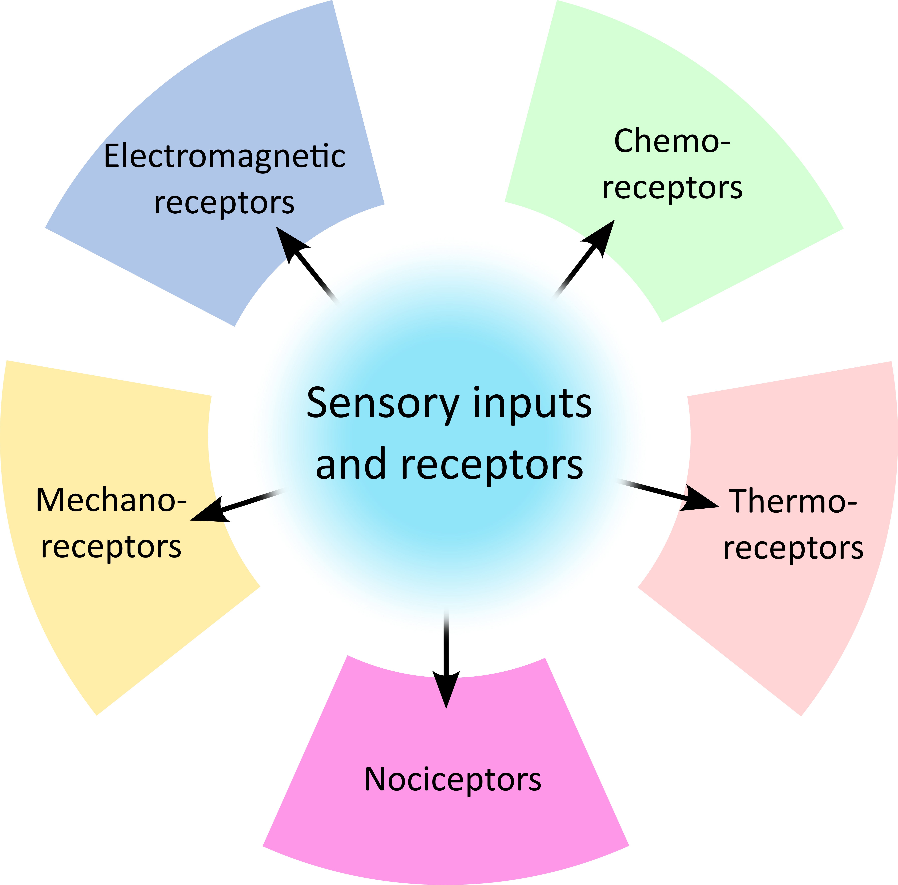
Sensory receptors
Taste
Vision
Smell
Touch
Proprioception
Hearing

Slide 3
Sensory receptors: mechanoreceptors (tactile)
Touch
Proprioception
Hearing

Slide 4
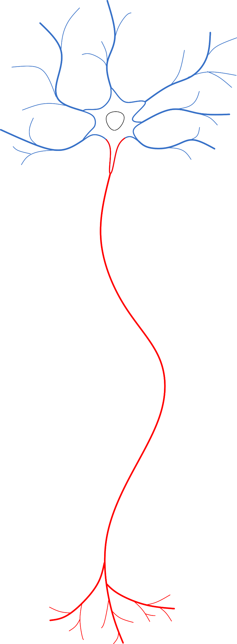
The neuron
Ability to process multiple inputs into an output
Specialized morphology
  Multitude of inputs → Dendrites
  Output → Axon
  Input neuron or target neuron can be very distant (projecting)
Excitable
  Voltage-/Ligand-gated ion channels
  Fast conduction of signals (myelin)
Axon
Initial Segment (AIS)
Terminals

Slide 5
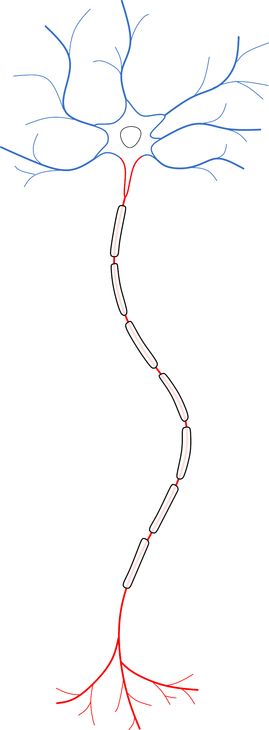
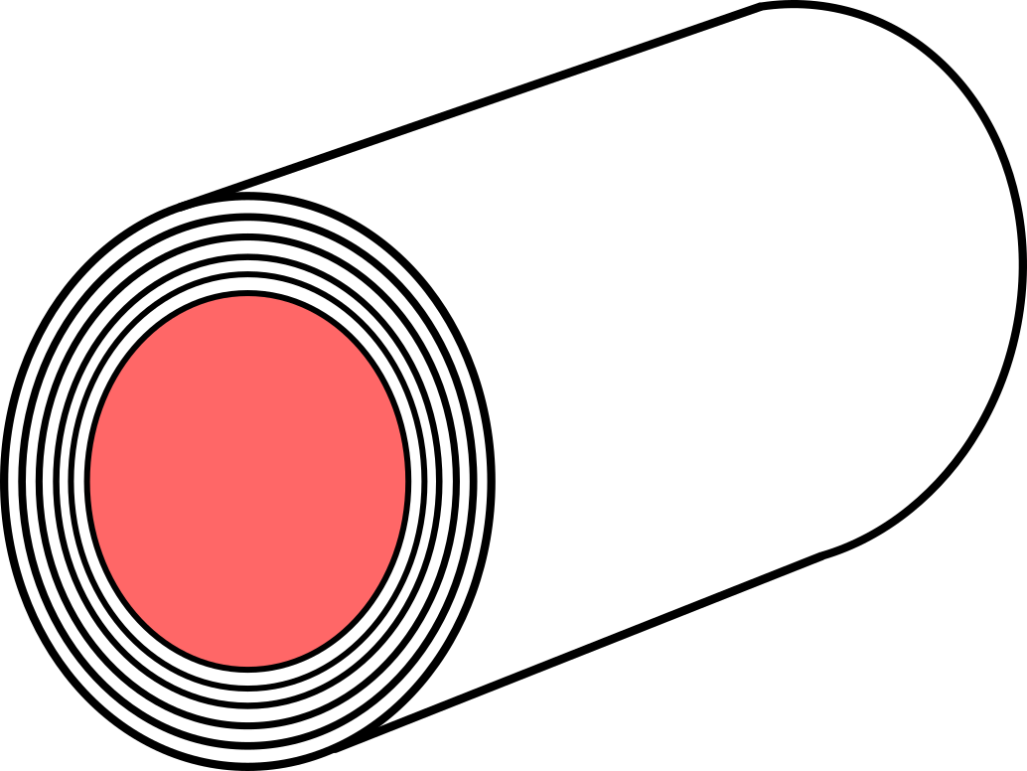
The neuron
Ability to process multiple inputs into an output
Specialized morphology
  Multitude of inputs → Dendrites
  Output → Axon
  Input neuron or target neuron can be very distant (projecting)
Excitable
  Voltage-/Ligand-gated ion channels
  Fast conduction of signals (myelin)
Axon
Initial Segment (AIS)
Nodes of
Ranvier
Myelin sheaths
Terminals

Slide 6
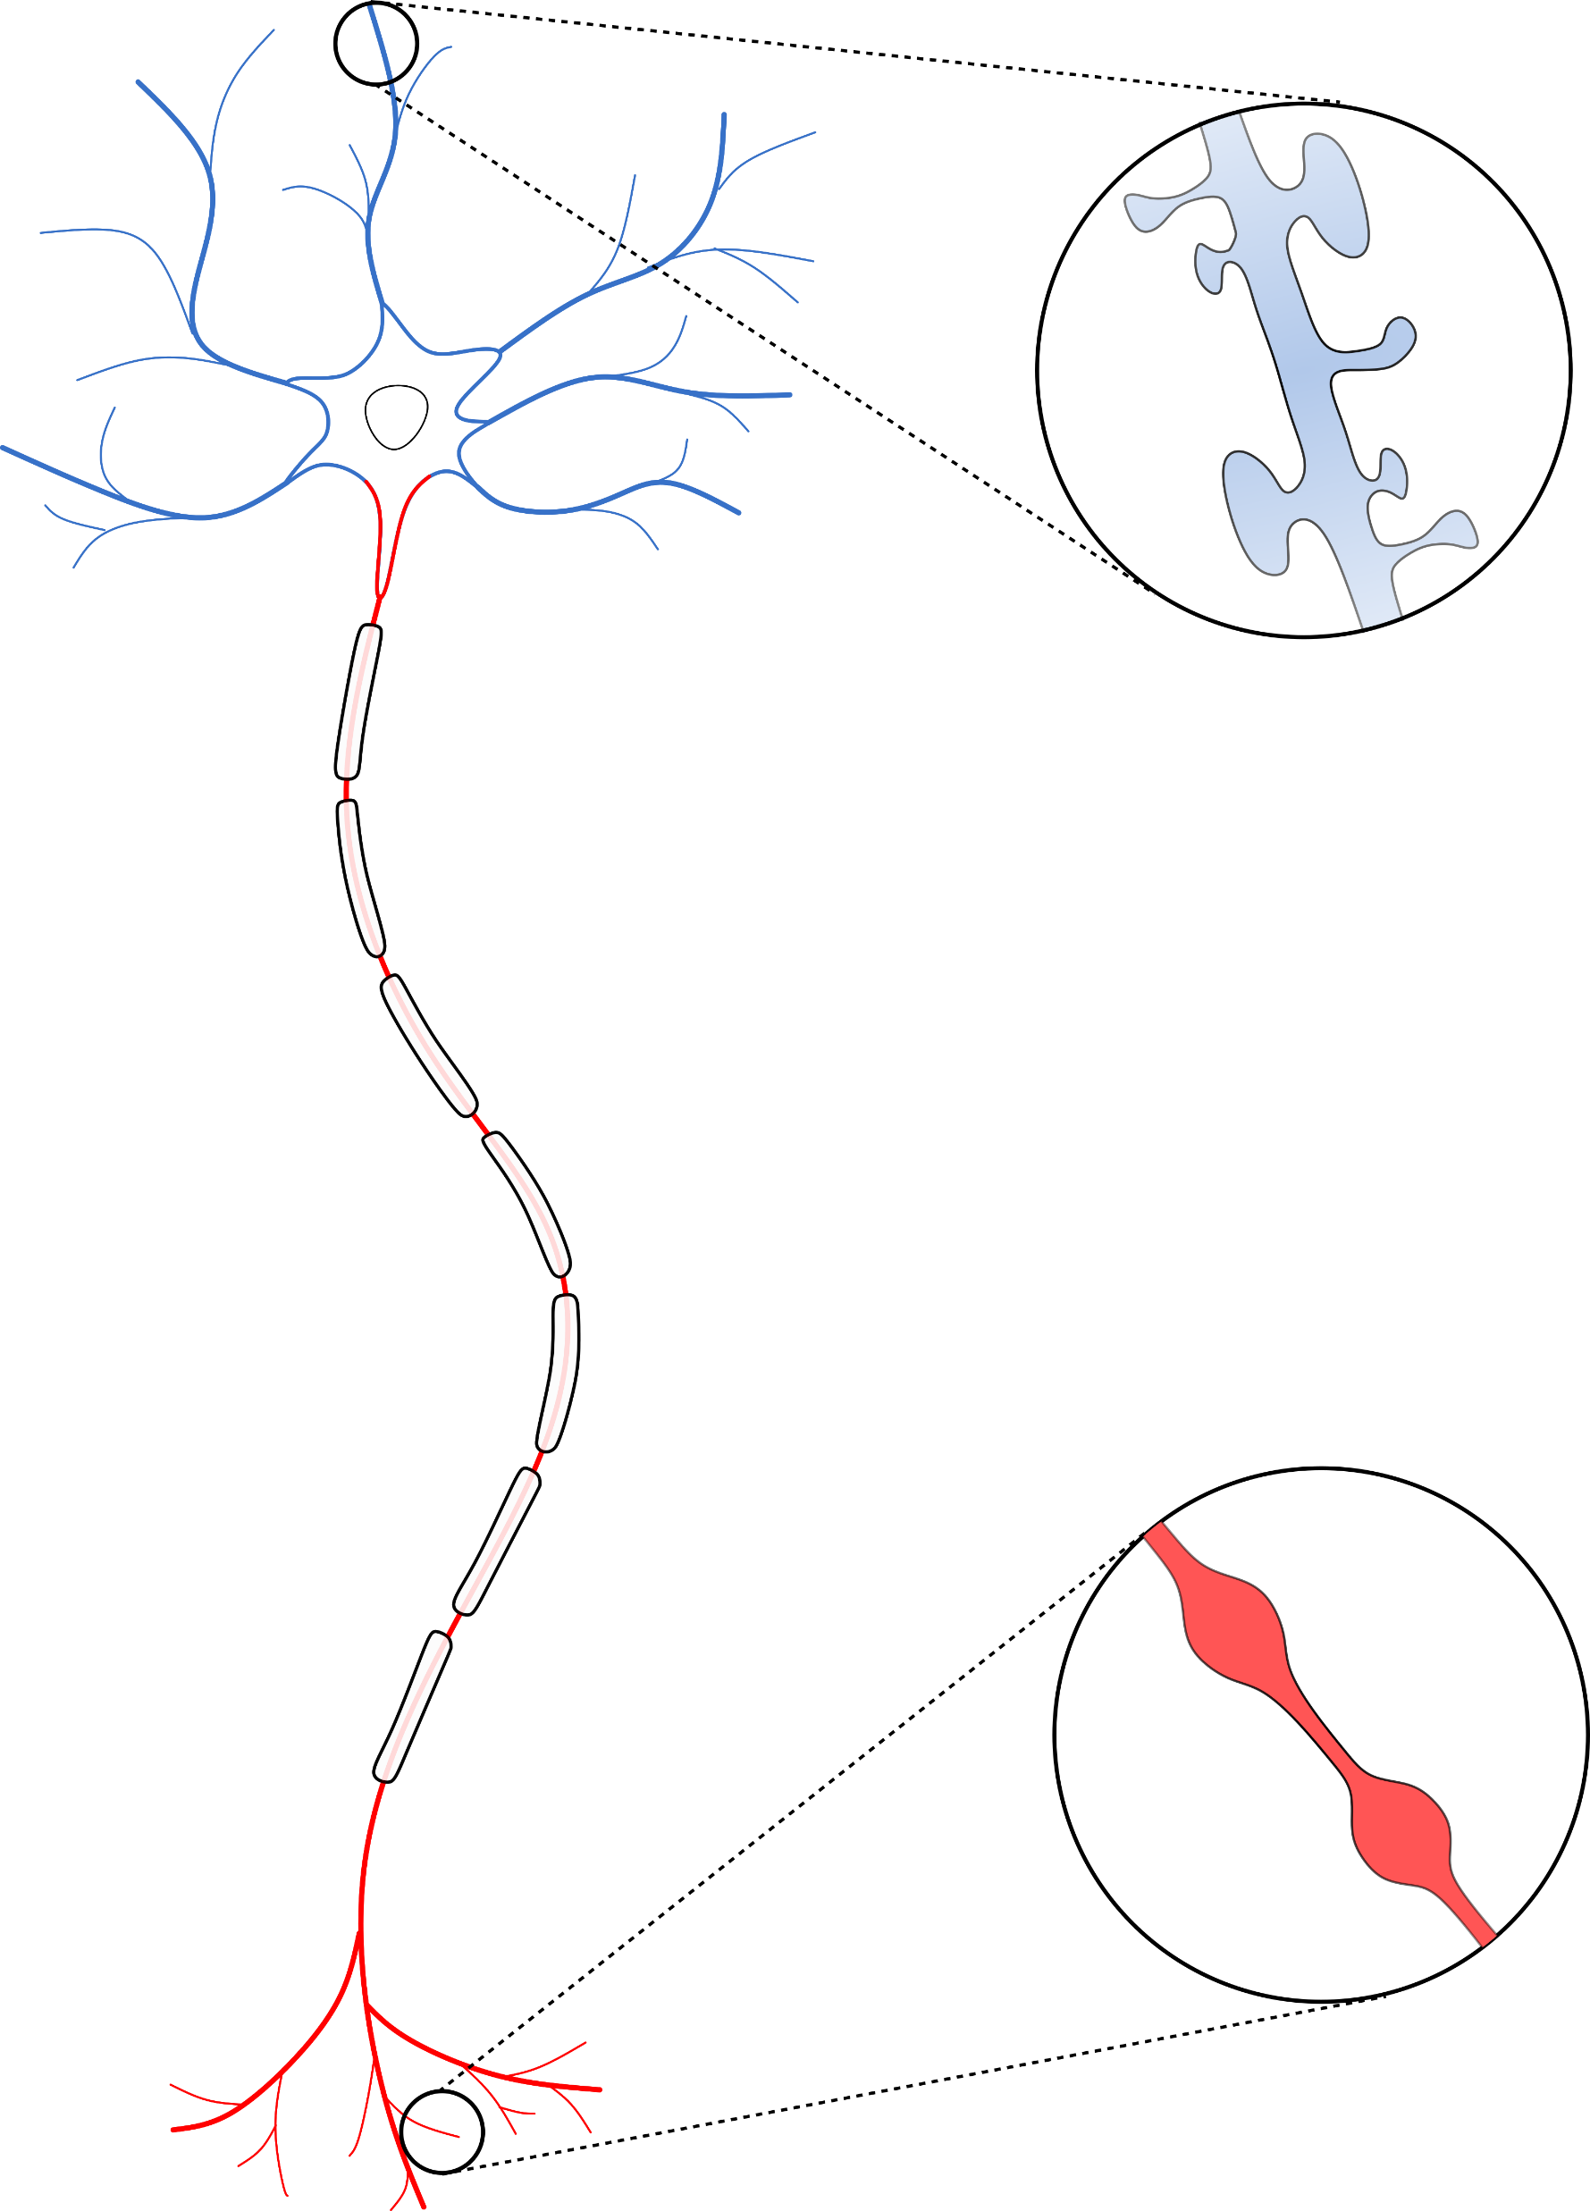
The neuron
Ability to process multiple inputs into an output
Specialized morphology
  Multitude of inputs → Dendrites
  Output → Axon
  Input neuron or target neuron can be very distant (projecting)
Excitable
  Voltage-/Ligand-gated ion channels
  Fast conduction of signals (myelin)
Axon
Initial Segment (AIS)
Dendritic
Spines
Nodes of
Ranvier
Myelin sheaths
Axonal Boutons
Terminals

Slide 7

Excitability
The ability of cells to change their membrane potential in response to stimuli
  Voltage, ligands, light, mechanical stimulation
Not just neurons
  Muscle cells, endocrine cells, cochlear hair cells, rods and cones in the retina
Expression of voltage- and/or ligand-gated ion channels
  Change in membrane potential trigger a conformational change which opens a pore
  Permeability to ions (Na⁺, Ca²⁺, K⁺, Cl⁻)

Slide 8
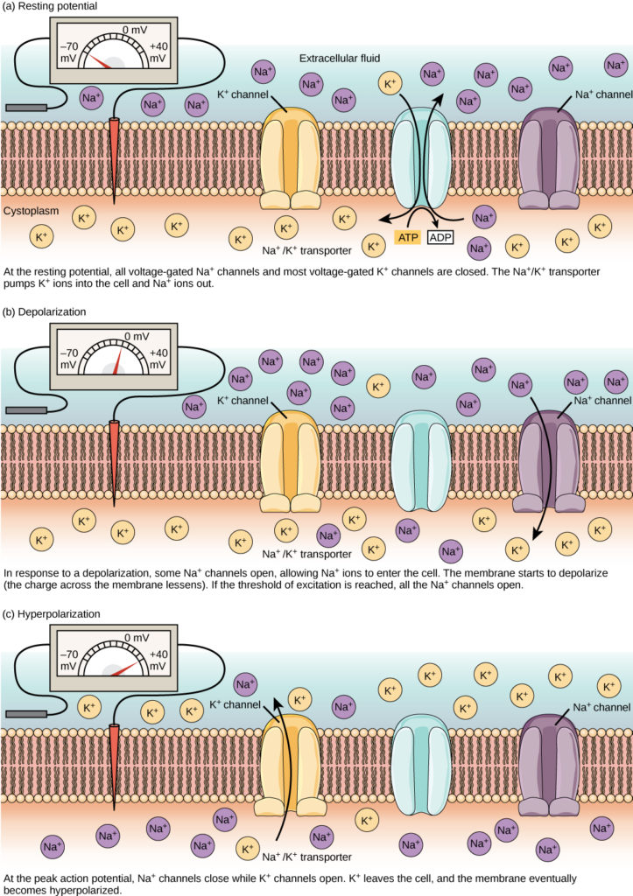
Action potential
At resting membrane potential
  Na⁺ and K⁺ channels are closed
Stimuli positively increase the membrane potential (voltage) (depolarization)
Upon reaching a voltage threshold, Na⁺ channels open
  Massive flow of Na⁺ ions inside the cell depolarizes even more the membrane potential
Further depolarization opens K⁺ channels
  Flow of K⁺ ions outside the cell reduces negatively the membrane potential (repolarization + hyperpolarization)
https://courses.lumenlearning.com/wm-biology2/chapter/resting-membrane-potential/

Slide 9
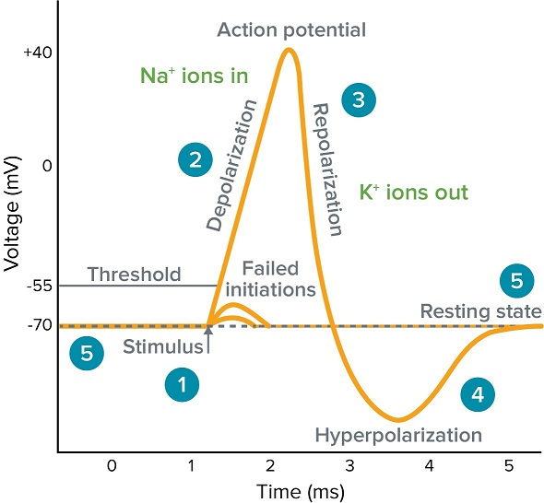
Action potential
At resting membrane potential
  Na⁺ and K⁺ channels are closed
Stimuli positively increase the membrane potential (voltage) (depolarization)
Upon reaching a voltage threshold, Na⁺ channels open
  Massive flow of Na⁺ ions inside the cell depolarizes even more the membrane potential
Further depolarization opens K⁺ channels
  Flow of K⁺ ions outside the cell reduces negatively the membrane potential (repolarization + hyperpolarization)
https://www.moleculardevices.com/applications/patch-clamp-electrophysiology/what-action-potential#gref

Slide 10
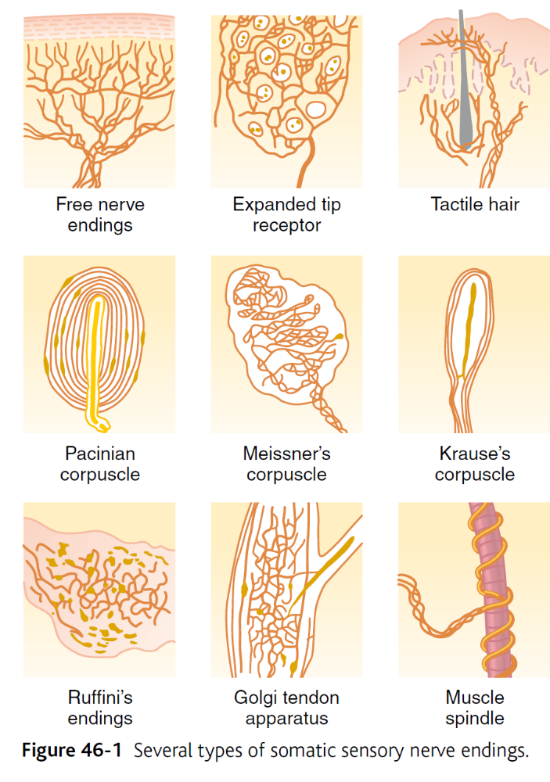
Different types of sensory fibres

Slide 11
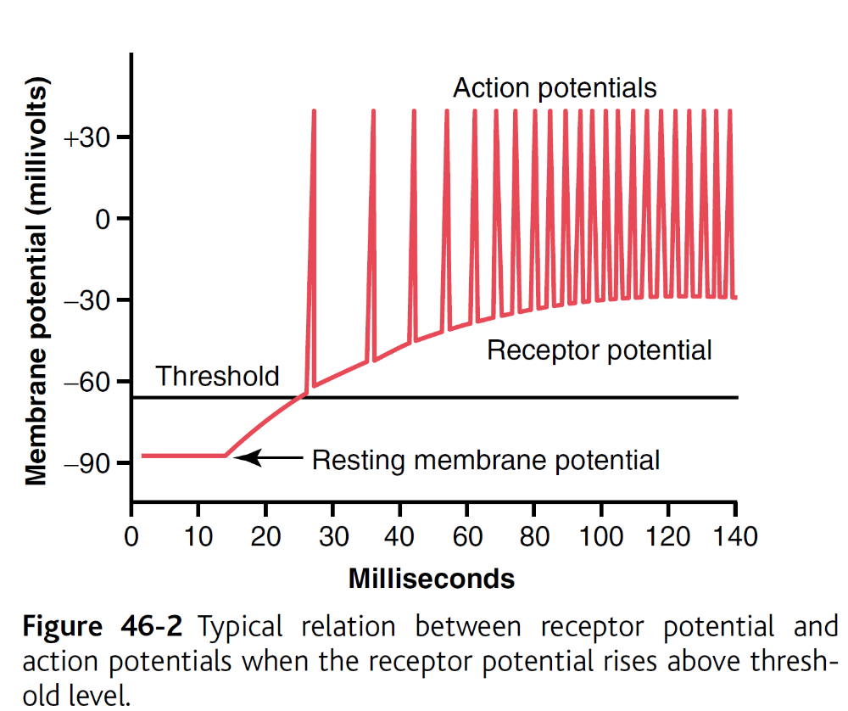
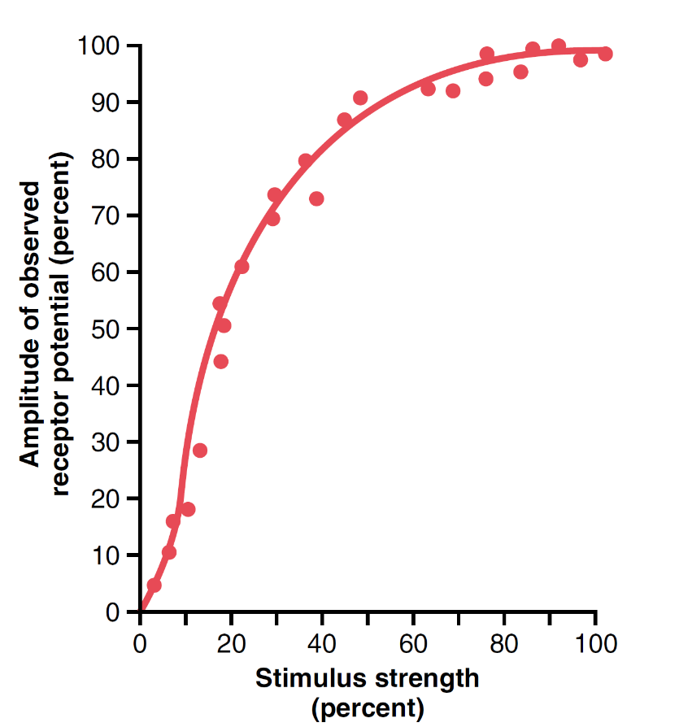
General properties of tactile receptors
Stimulus effect on AP from receptors
  Intensity
  Amplitude and frequency

Slide 12
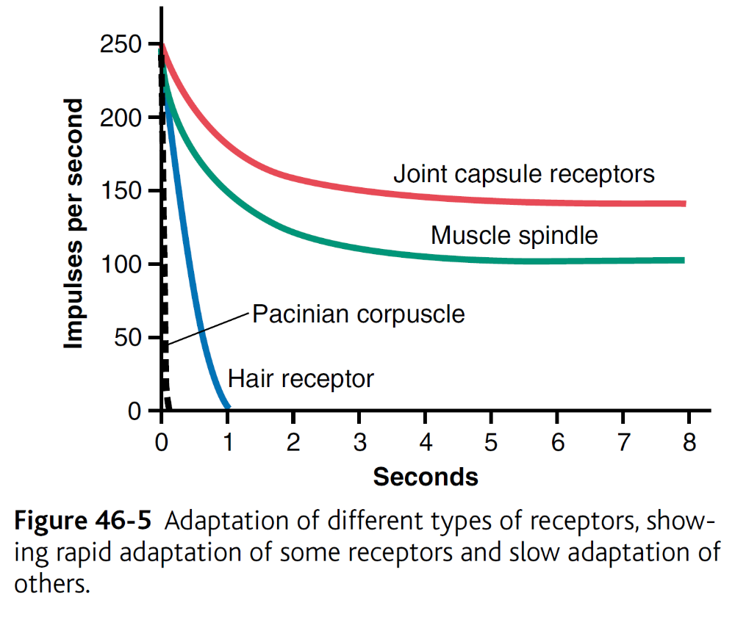
General properties of tactile receptors
Stimulus effect on AP from receptors
  Intensity
  Amplitude and frequency
Adaptation of receptors
  Rapid-adapting (change receptors) → Rate receptors, movement receptors, phasic receptors
  Slow-adapting (tonic)→ receptors of the macula in the vestibule, nociceptors, baroreceptors, chemoreceptors of the aorta and carotid bodies

Slide 13
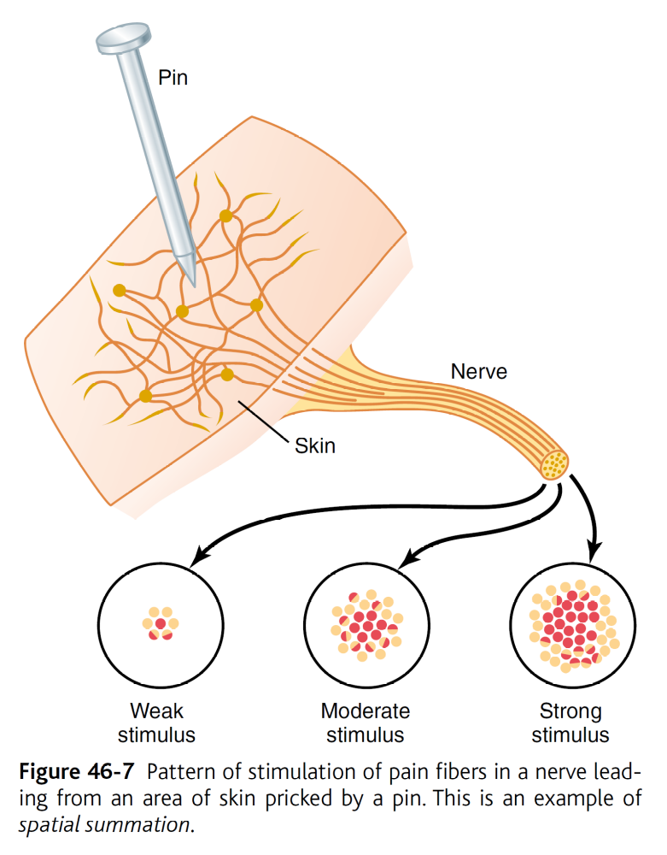
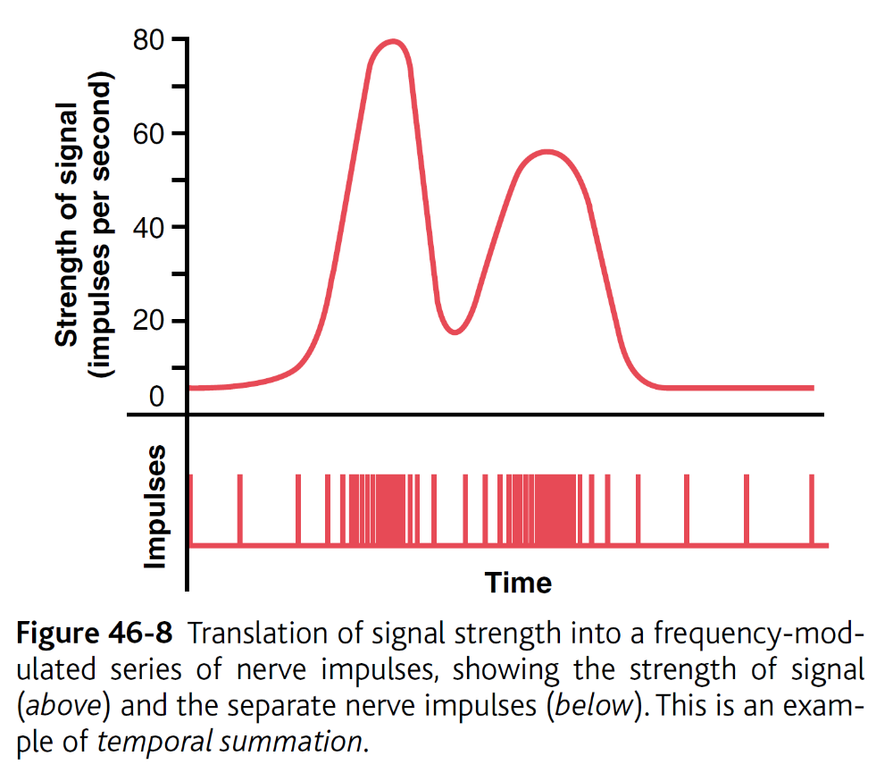
Sensory processing
Spatial summation
Temporal summation

Slide 14
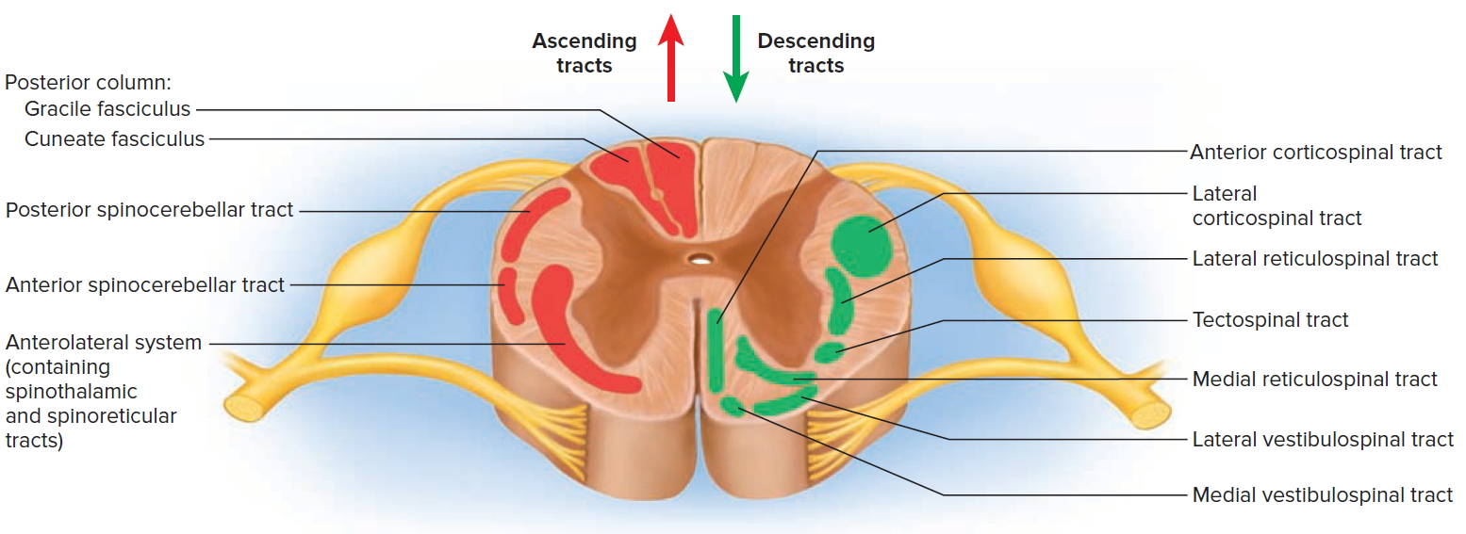
The spinal cord

Slide 15
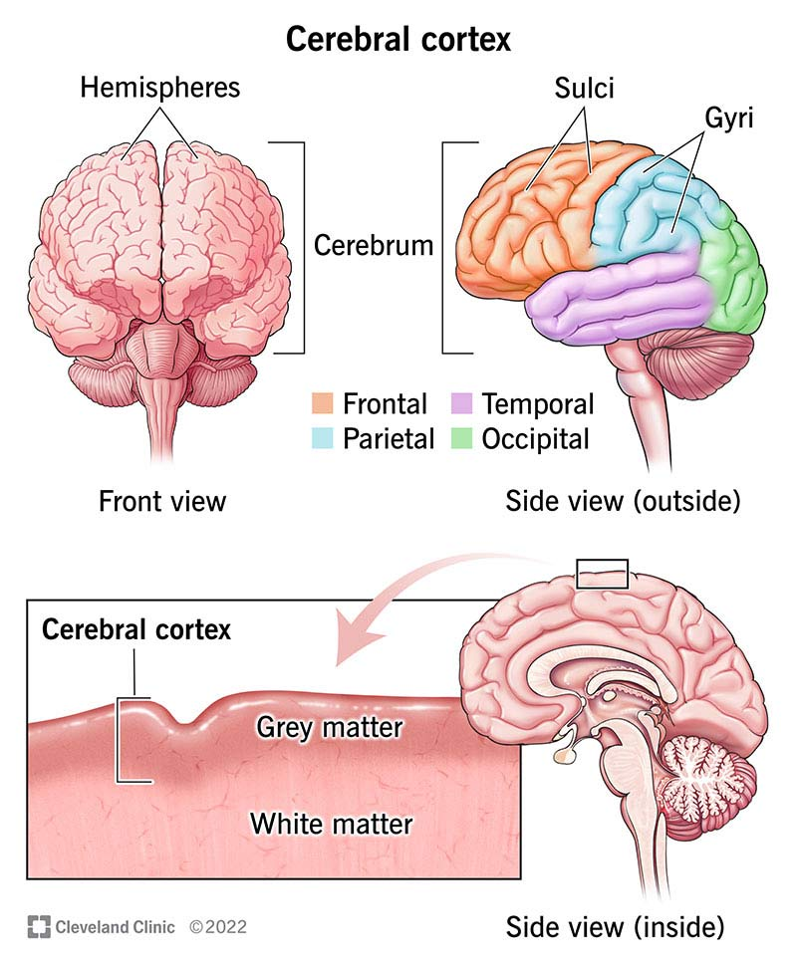
The Brain

Slide 16
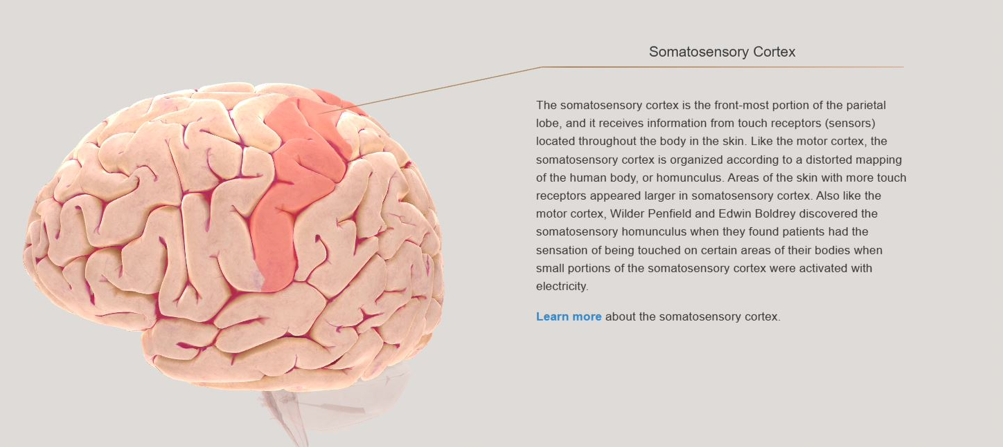
The Brain: the somatosensory cortex

Slide 17
Tactile receptors

Slide 18
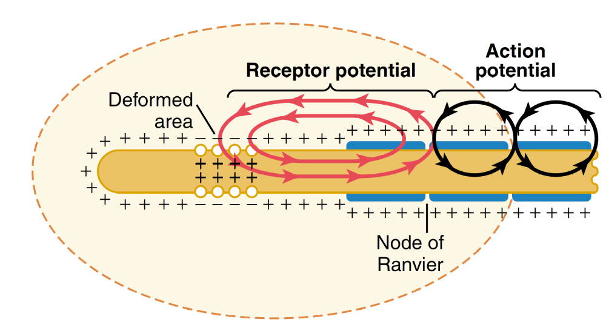
Tactile receptors
Aα and Aβ fibres
One central nerve ending surrounded by a layered capsule
Viscous fluid between capsule layers
Rapid tissue deformation
Very rapid adaptation

Slide 19
Tactile receptors
Everywhere in skin and other tissues
Aδ fibers and some C fibers
Touch and pressure
  Tickle and itch
Only receptors present on the cornea

Slide 20
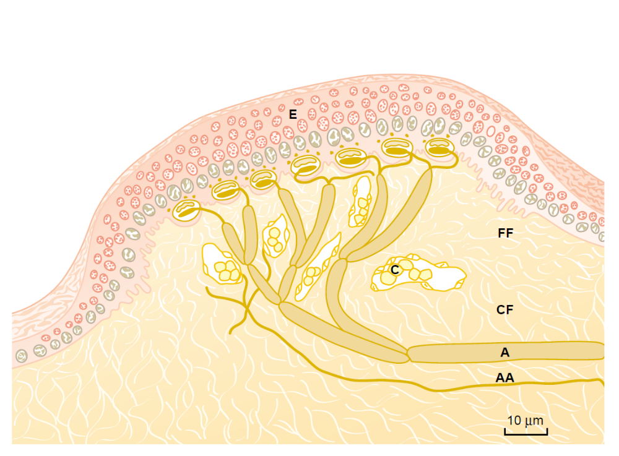
Tactile receptors
Many Merkel’s discs
  Expanded tip tactile receptors
  Abeta fibers ending + Merkel’s cells
Fingertips and other areas with Meissner’s corpuscles
  Moderately in other hairy areas
Strong and adapting signal, followed by weaker and slow-adapting
  Continuous touch
High tactile acuity for objects’ features, like texture, shape and edges
Iggo dome
receptors
Merkel’s
disc

Slide 21
Tactile receptors
Aβ and Aγ fibres
Nerve ending at the base of the hair
High adaptation
Detection of moving objects and initial contact

Slide 22
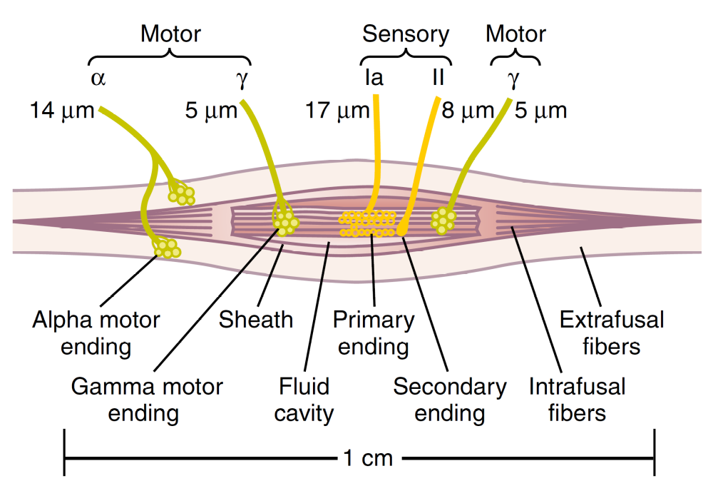
Tactile receptors in proprioception: muscle spindle
Senses length and change of length from intrafusal muscle fibers
  Different from extrafusal muscle fibers
Responses to changes in muscle length
Ia fibers
Support from secondary II fiber receptors
Important for inhibitory reflex

Slide 23
Tactile receptors in proprioception: golgi tendon apparatus
Detect muscle tension
10-15 muscle fibers for each Golgi tendon organ
Important for inhibitory reflex
Equalises the tension among muscle fibers

Slide 24
Tactile receptors: skin
Receptor | Location | Nerve Fiber | Speed | Adaptation | Stimulus
Free-nerve endings | Skin,cornea and others | Aδ and C-fibres | 0.5-2 m/s | Slow | Touch and pressure
Meissner’s corpuscle | Non-hairy skin (fingertips) | Aβ fibres | 30-70 m/s | Fast | Movement and vibration
Merkel’s disc | Non-hairy (fingertips) and hairy (low) skin | Aβ fibres | 30-70 m/s | Composite (fast + slow) | Tactile acuity (object features)
Tactile hair | Skin | Aβ and Aγ fibres | 10-80 m/s | Fast | Movement and initial contact
Ruffini’s endings | Deep skin, internal tissues, joint capsule | Aβ fibres | 30-70 m/s | Slow | Prolonged touch and pressure
Pacinian corpuscle | Below skin, deep fascial tissues | Aβ fibres | 30-70 m/s | Fast | Rapid tissue compression

Slide 25
Tactile receptors: Muscle and joints
Receptor | Location | Nerve Fiber | Speed | Adaptation | Stimulus
Muscle spindle | Intrafusal muscle fibers | Aα and Aβ fibres | 70-120 m/s and 30-65 m/s | Slow and fast | Position and movement
Ruffini’s endings | Joint capsule | Aβ fibres | 30-70 m/s | Slow | Joint capsule stretch
Pacinian corpuscle | Joint capsule | Aβ fibres | 30-70 m/s | Fast | Joint capsule compression
Golgi tendon apparatus | Tendons | Aα fibres | 70-120 m/s | Fast | Muscle tendons stretch

Slide 26
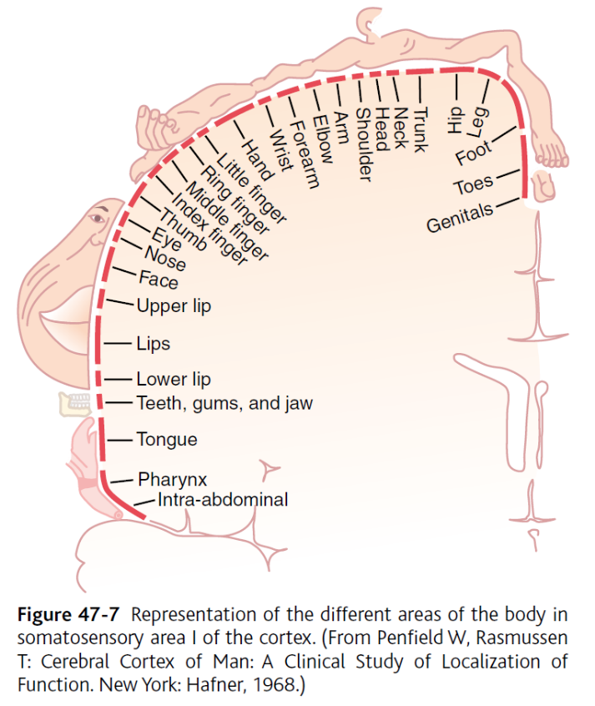
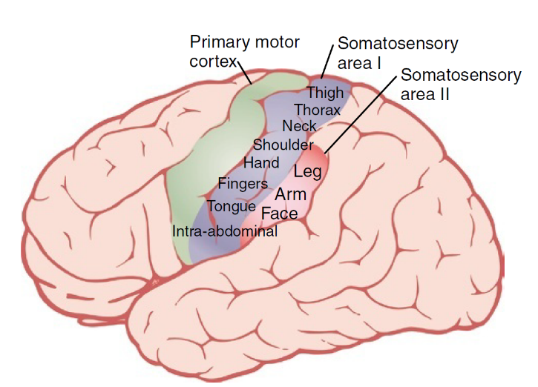
Tactile receptors: signal to the brain

Slide 27
Tactile receptors in proprioception: muscle spindle

Slide 28
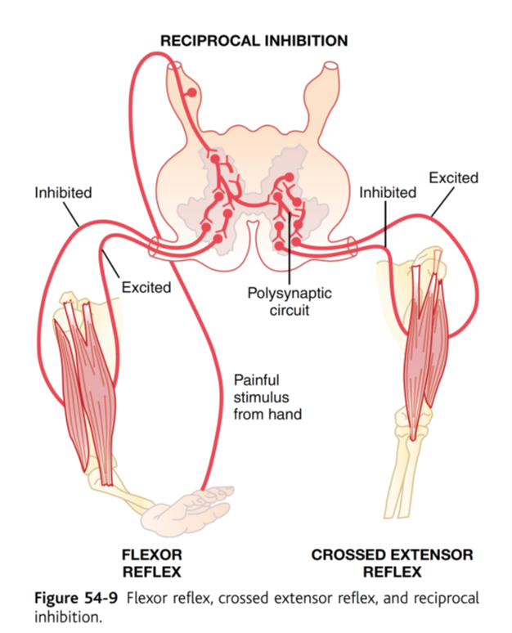
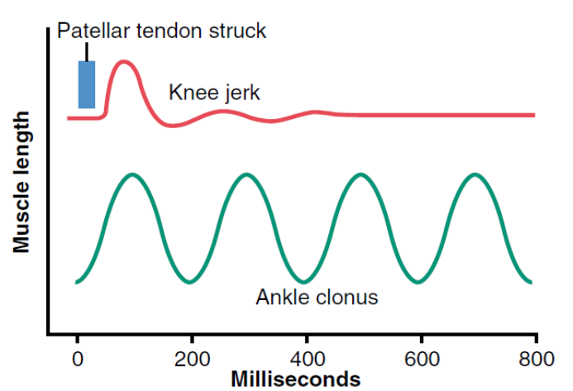
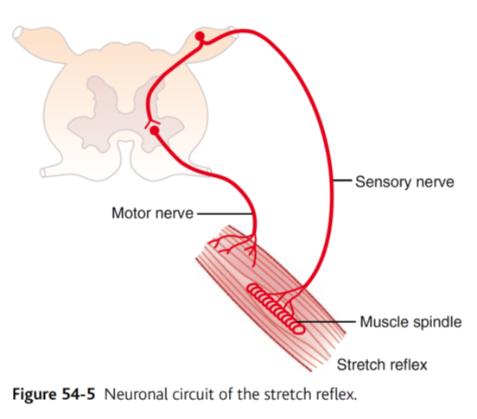
Muscle reflexes

Slide 29
Sensory receptors: hearing
Hearing

Slide 30
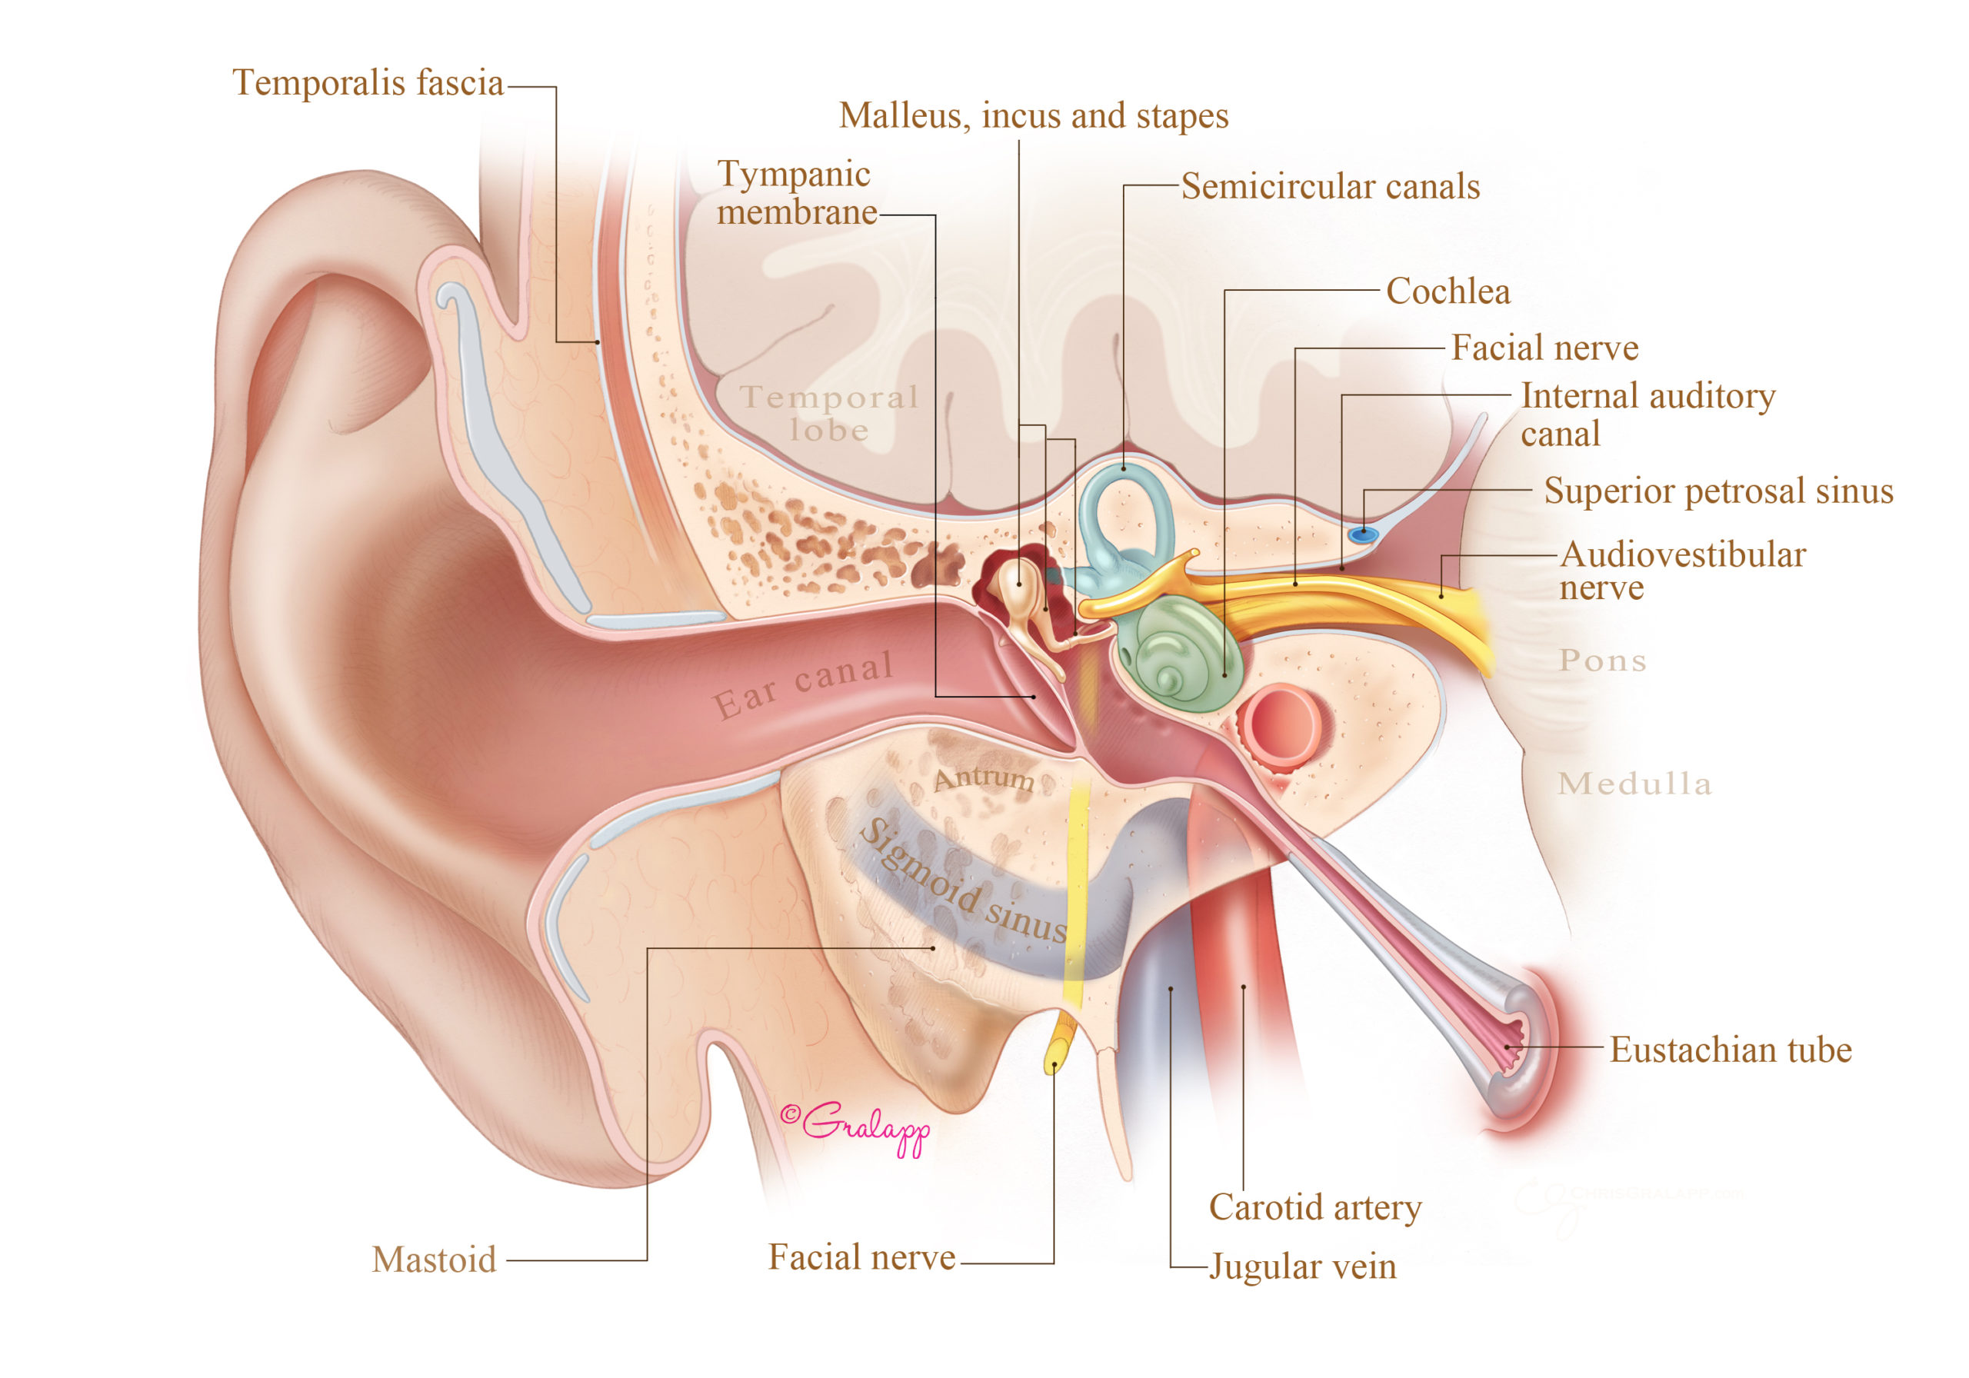
Hearing
Tympanic membrane (ear drum)
Ossicles
  Malleus
  Incus
  Stapes
Cochlea (inner ear)
  Oval window
  Membranous labyrinth

Slide 31
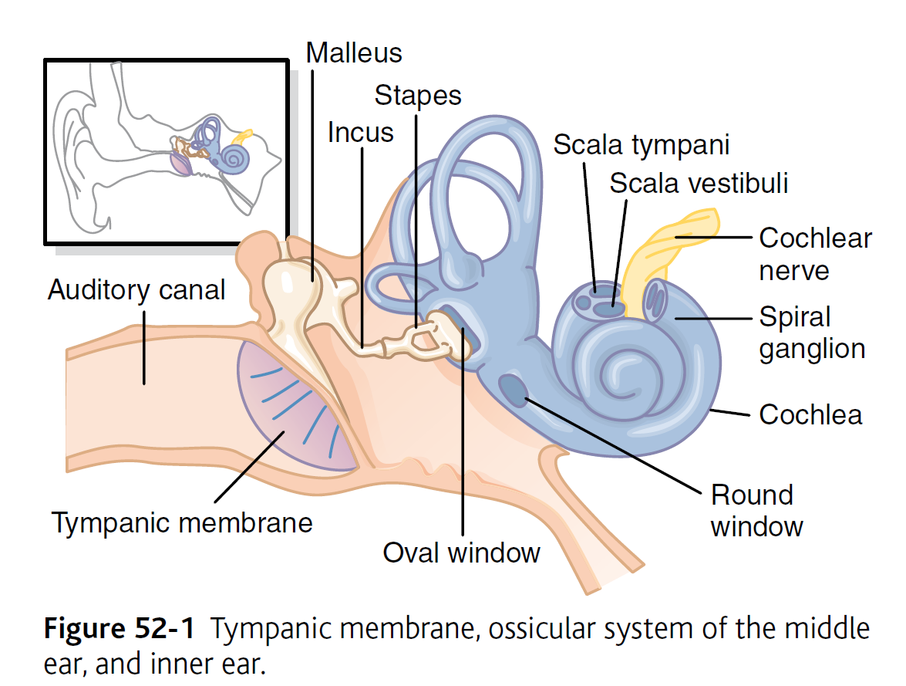
Hearing: the ossicles
Tympanic membrane (ear drum)
Ossicles
  Malleus
  Incus
  Stapes
Cochlea (inner ear)
  Oval window
  Membranous labyrinth

Slide 32
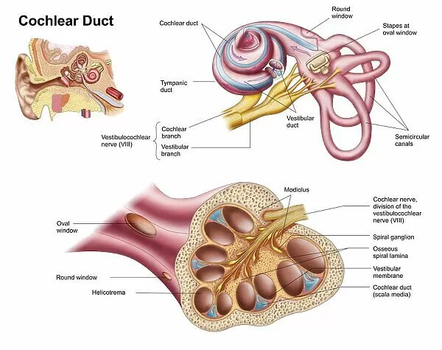
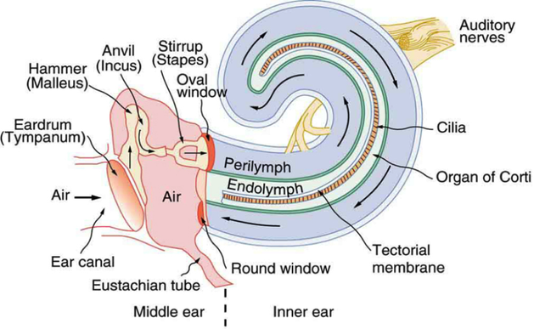
Hearing: the cochlea
Tympanic membrane (ear drum)
Ossicles
  Malleus
  Incus
  Stapes
Cochlea (inner ear)
  Oval window
  Membranous labyrinth

Slide 33
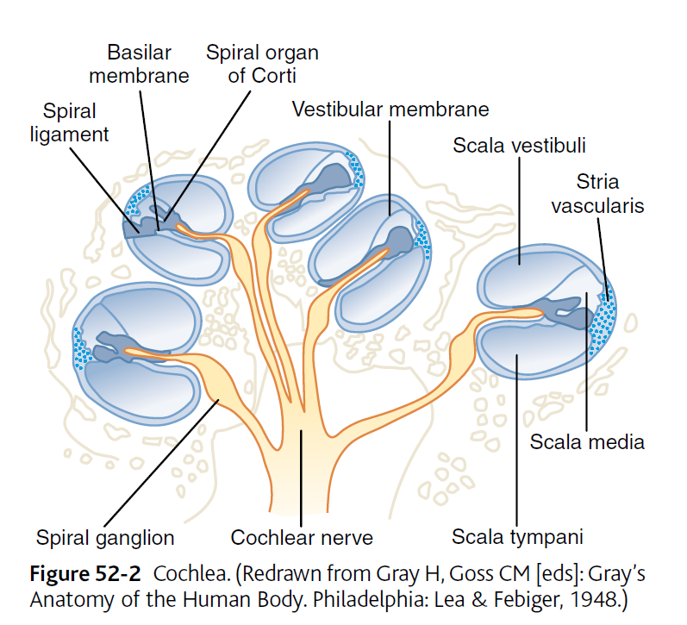
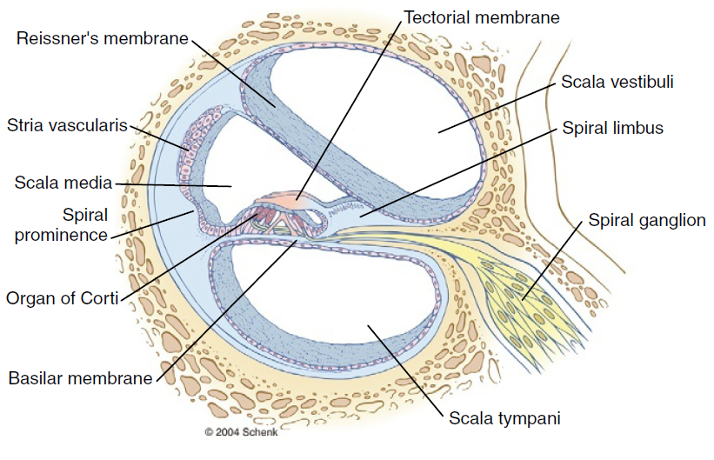
Hearing: the cochlea
Endolymph
Perilymph
Endolymph
Perilymph

Slide 34
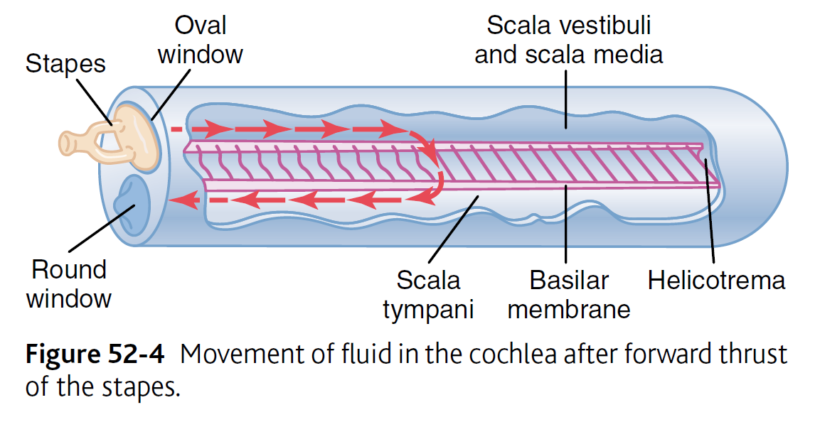
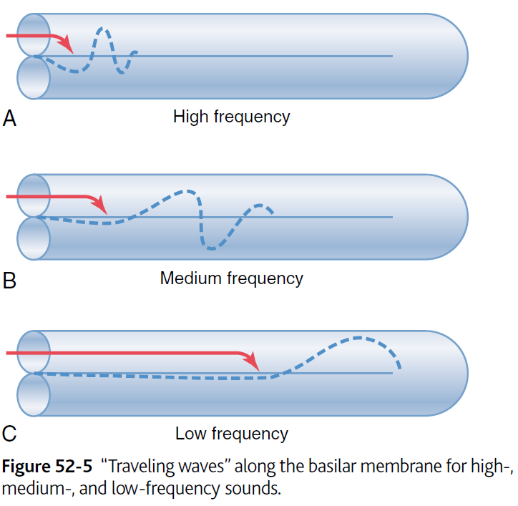
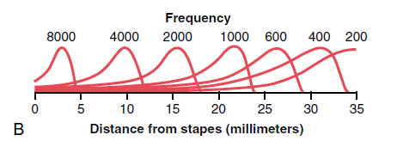
Sound propagation along the cochlea

Slide 35
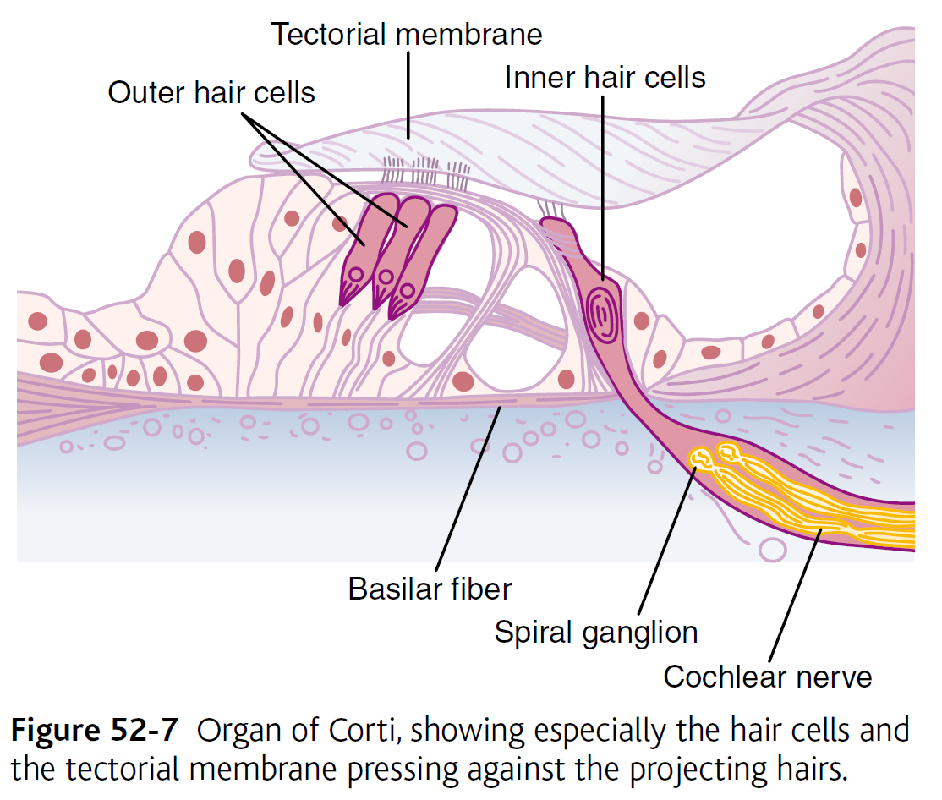
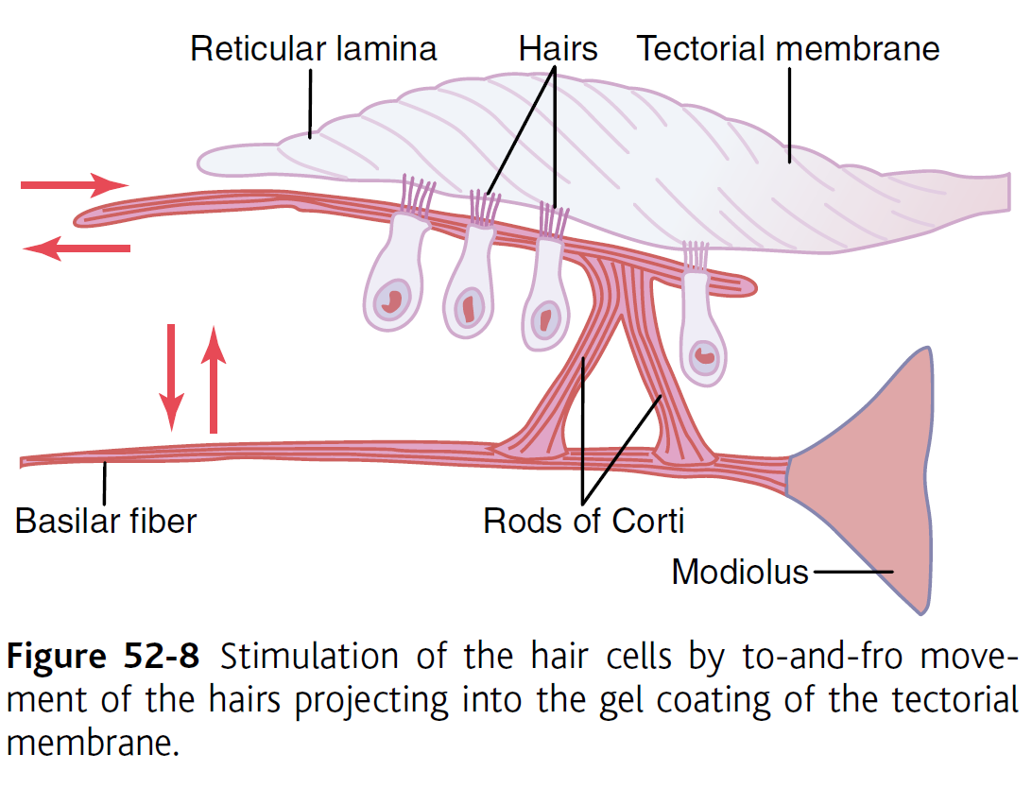
Hearing: the organ of Corti
(tuning function)
(90% of auditory input)
Endolymph
Perilymph

Slide 36
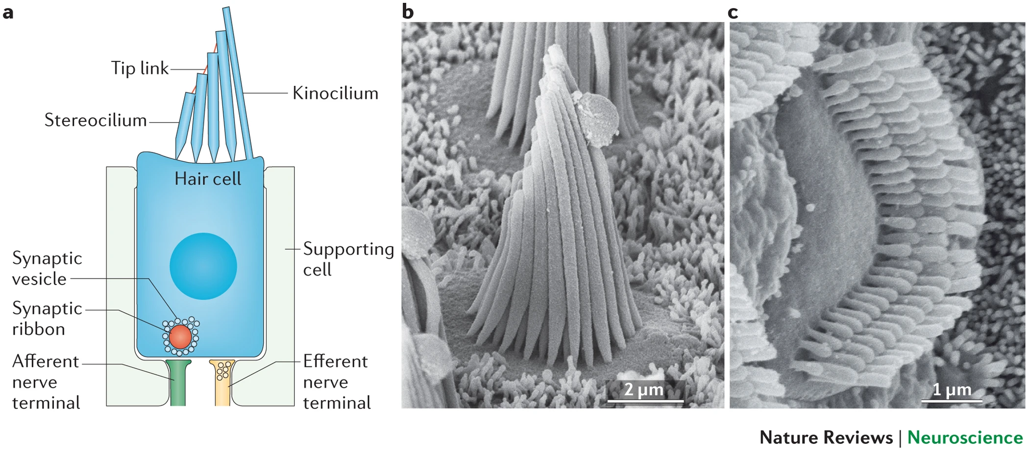
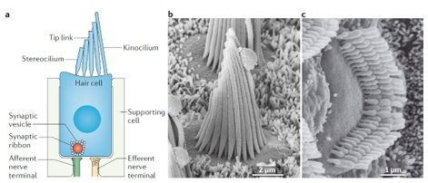
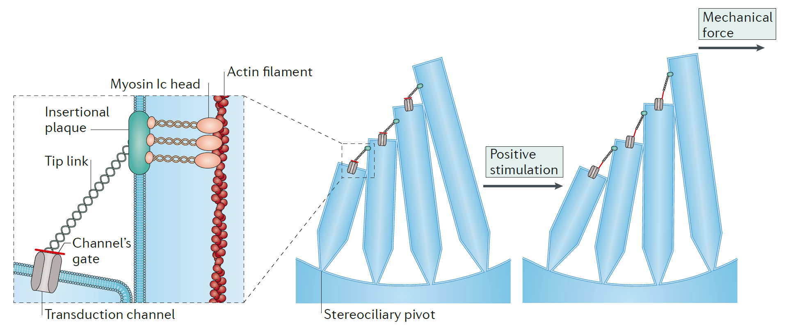
Hearing: the hair cells

Slide 37
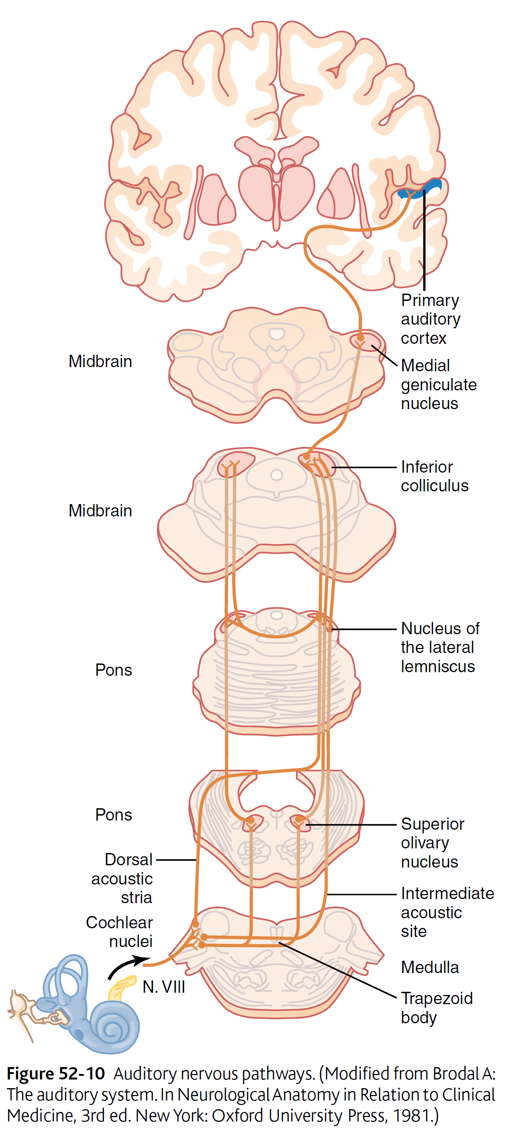
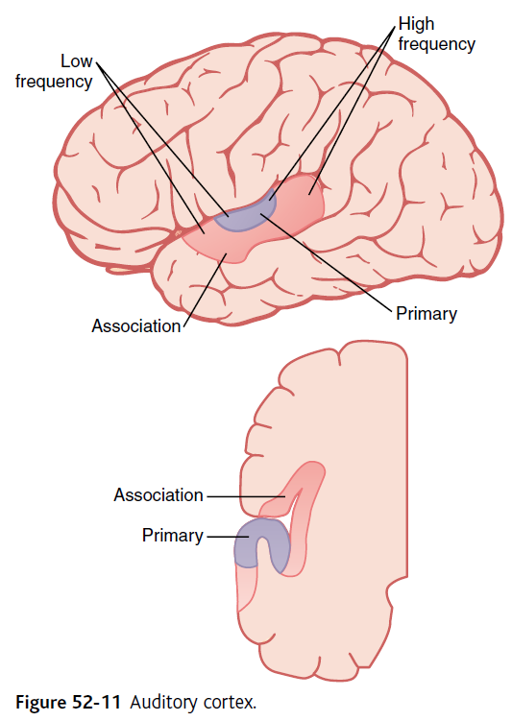
Hearing: signal to the brain

Slide 38
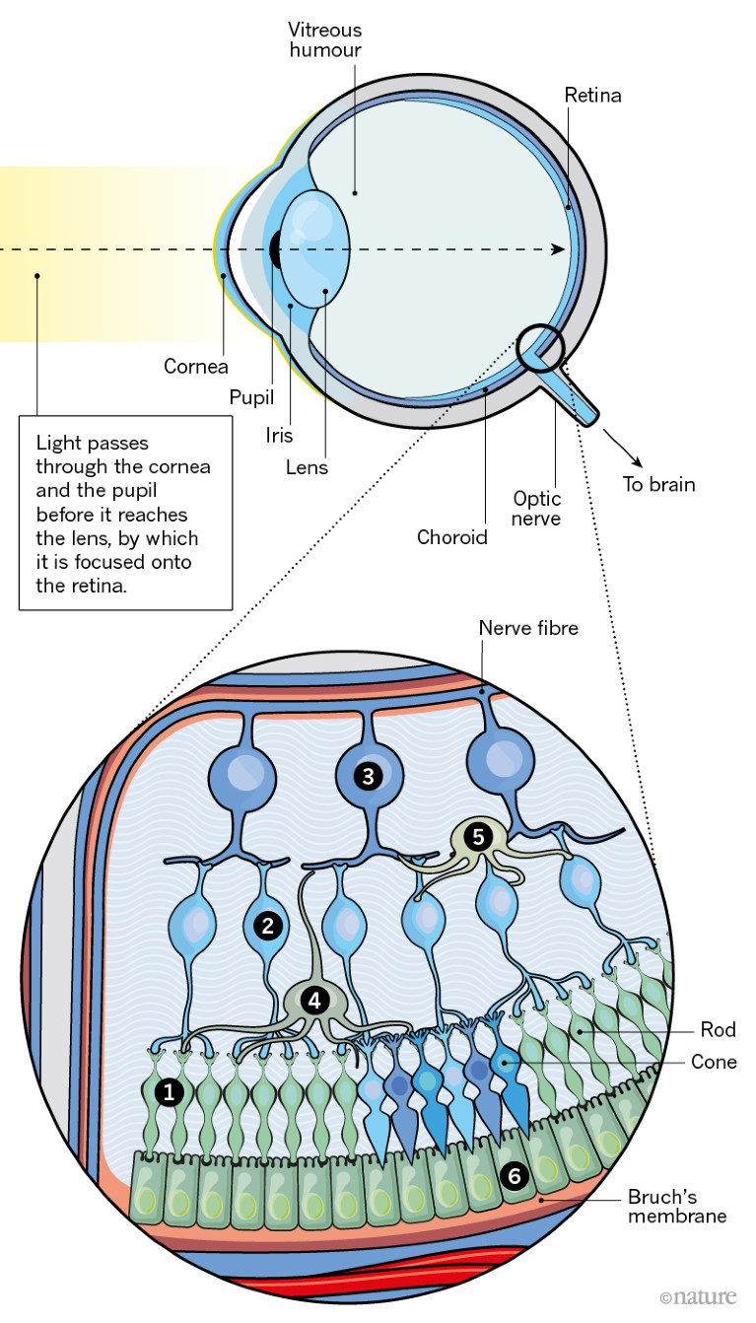
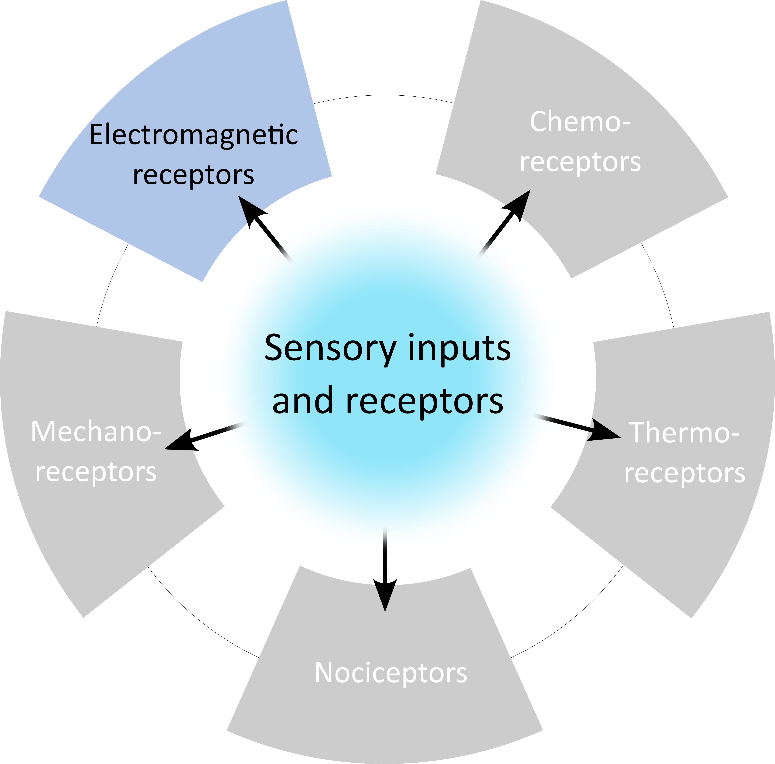
Sensory receptors: vision
Vision

Slide 39
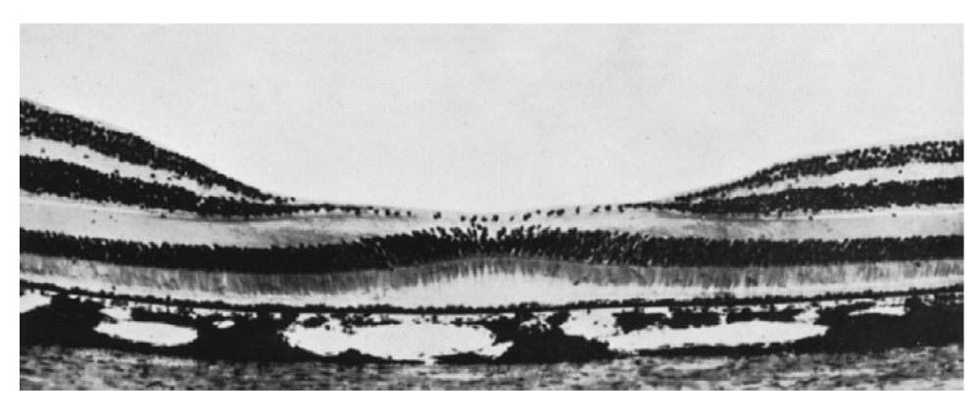
Vision: the retina
Visual actuity is maximal at the fovea!

Slide 40
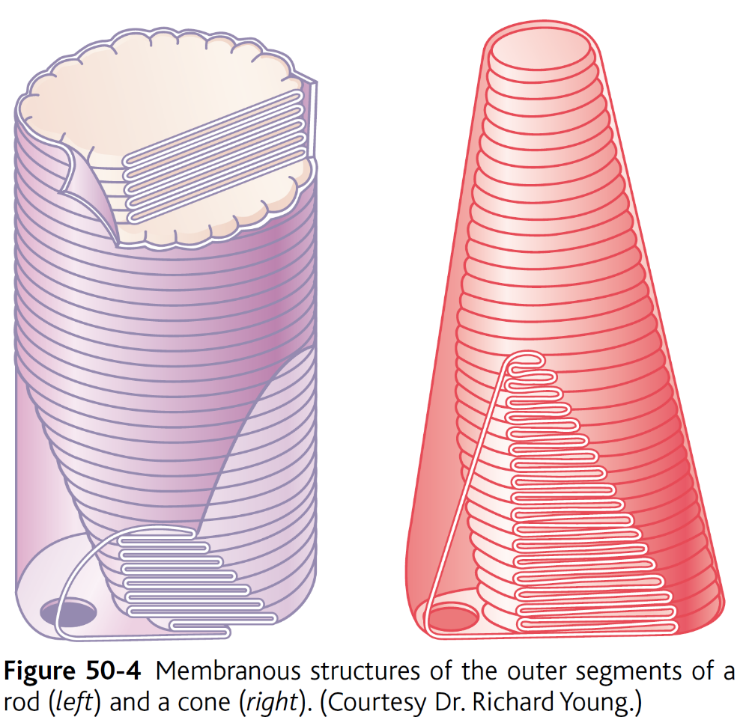
Vision: rods and cones

Slide 41
Vision: rhodopsin

Slide 42
Vision: activation of photoreceptors

Slide 43
Vision: color photoreceptors

Slide 44
Vision: color blindness

Slide 45
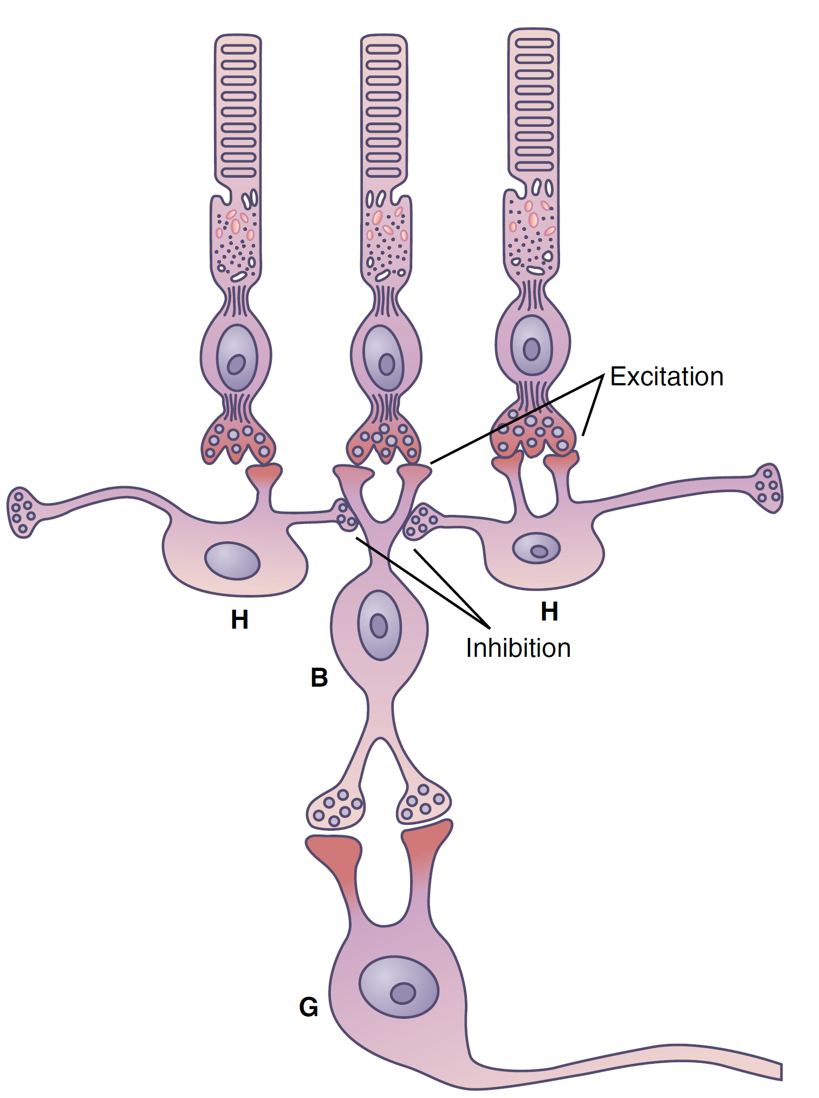
Vision: signal processing in the retina
100 million rods/ 3 million cones
1.6 ganglion cells → 60 rods and 2 cones for each ganglion cell
Lateral inhibition in the retina
  Horizontal cells and amacrine cells

Slide 46
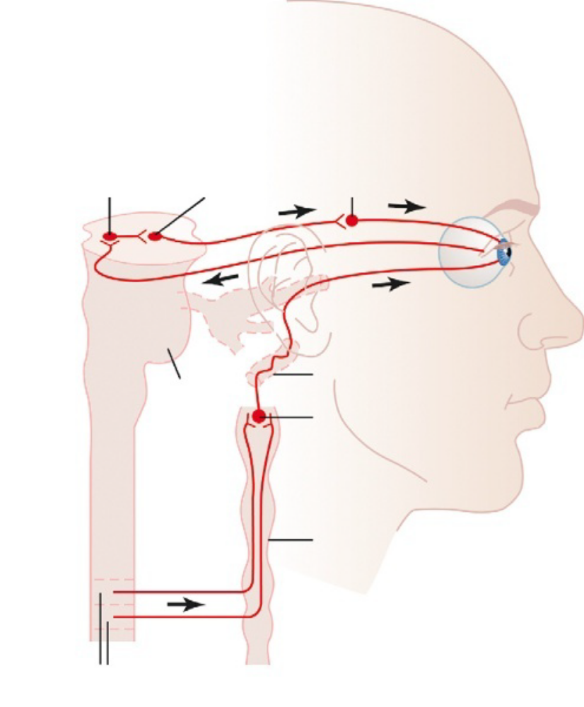
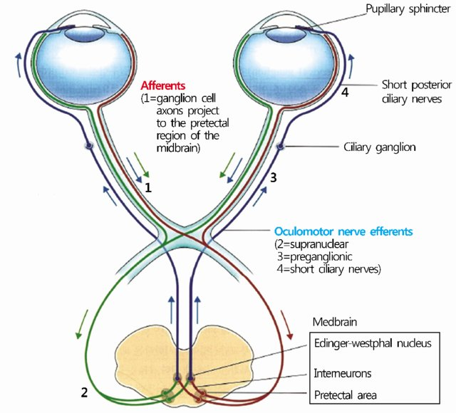
Pupillary reflex

Slide 47
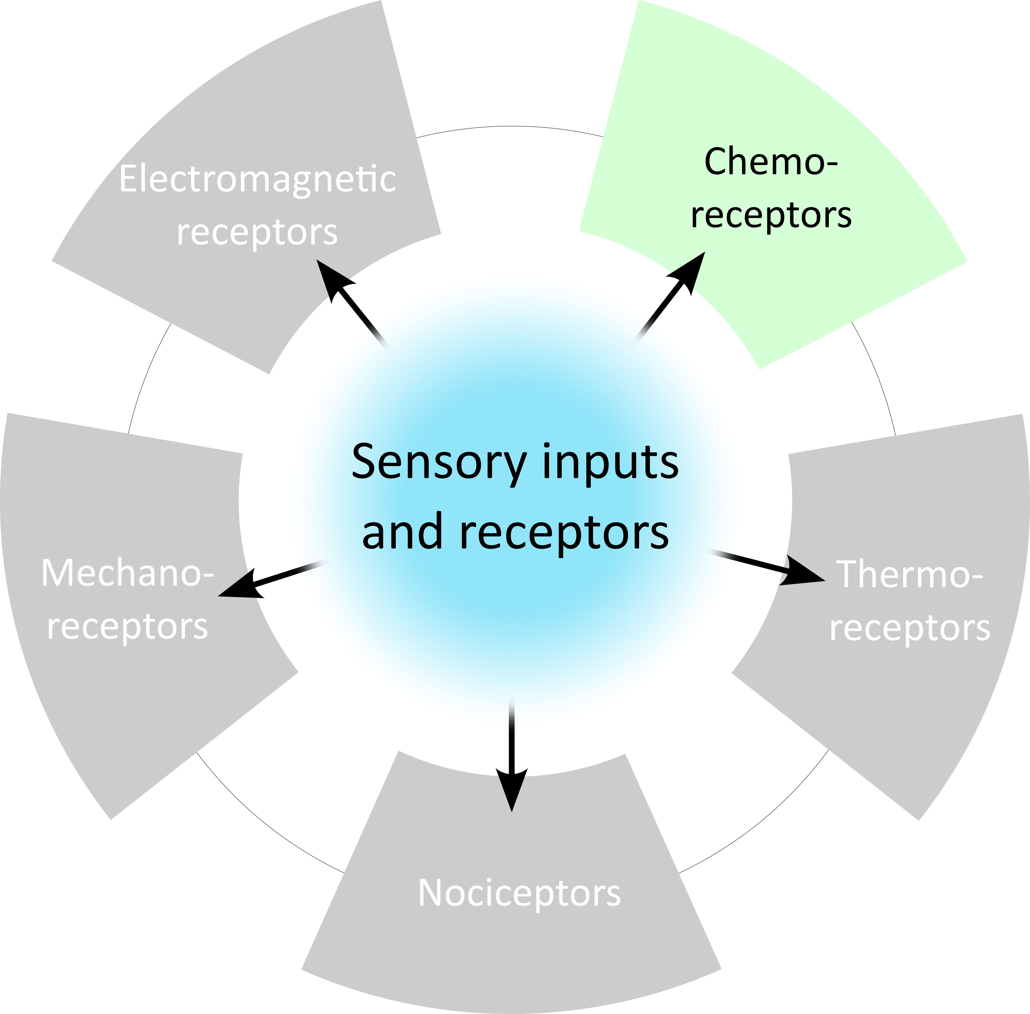
Sensory receptors: taste
Taste
Smell

Slide 48
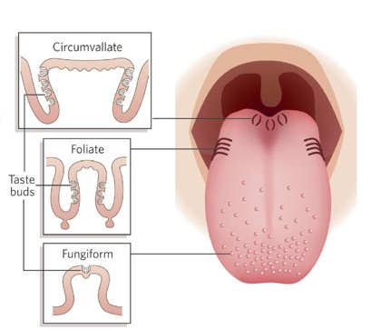
Taste buds

Slide 49
Taste bud cells
Type I cells - 50%
  Glia-like functions – elimination of neurotransmitters and spatial buffering of K⁺
Type II Cells - 30% (sweet/bitter/umami)
  mostly organic chemicals (sugars, glycols, alcohols, aldehydes, ketones, etc)
  mostly organic chemicals (long-chain organic substances and alkaloids)
  L-glutamate
Type III cells - 2-10%
  Sour taste
Intercellular communication
  Type II and type III cells - ATP, serotonine and GABA
  Type III to nerve fibres via serotonine and glutamate
Notes:
Sour Taste: H+ concentration
Salty taste: cations, mainly Na+, but also some anions
Sweet taste: various compounds (mostly organic chemicals) including sugars, glycols, alcohols, aldehydes, ketones, amides,
esters, some aa, some small proteins, sulfonic acids, halogenated acids and inorganic salts like lead and beryllium
Bitter taste: various compounds (mostly organic chemicals). Main two types are (1) long-chain organic substances
that contain H+ or (2) alkaloids (many poisonous compounds from plants), like caffeine quinine strychnine and nicotine
Umami taste: mainly L-glutamate, mechanism still unclear.

Slide 50
Taste receptors
Type I receptors (T1R) - GPCRs
  Venus flytrap module (VFM)
  T1R2/ T1R3 heterodimers recognize sweet taste
  T1R1/ T1R3 heterodimers recognize umami taste
Type II receptors (T2R) - GPCRs
  Function as monomers
  20 or more genes encoding for T2Rs
GLUT and SGLT1 - transporters
  Alternative sensing of glucose
  SGLT1 → Na+/Glucose transporter - possible explanation for salt enhancing sweet taste!

Slide 51
Taste signal processing

Slide 52


Reflexes - Cephalic phase of insulin release

Slide 53
Sensory receptors: smell
Taste
Smell

Slide 54


Smell

Slide 55

The olfactory bulb

Slide 56
The olfactory receptors

Slide 57

The olfactory receptors
Over 400 different olfactory receptors!

Slide 58
Olfactory signals processing

Slide 59
More than the 5 senses!
pH
Osm

Slide 60

Questions?
For follow-up questions:
vincenzo.mastrolia@kcl.ac.uk
Specific reading:
  Guyton and Hall - Textbook of Medical Physiology 12th ed (2011) ISBN: 978-0-8089-2400-5
  Constance Hammond – Cellular and Molecular Neurophysiology 4th ed (2015) ISBN: 978-0-12-397032-9
  Greg Stuart, Nelson Spruston, Micheal Häusser – Dendrites 3th ed (2016)
  ISBN 978–0–19–874527–3

